Slide 1
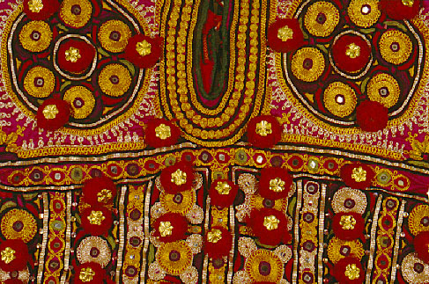
India in The 20th Century

Slide 2
Powerful empires ruled India for much of its history. The first was the
Mughal Empire.
Established in 1526 and led by Babur (BAH-boohr)
Akbar became one of India’s greatest leaders, and trade greatly increased.
There was a high demand for Indian goods like spices and tea.
Guess who was next????

Slide 3
The British come to India
As the Mughal Empire declined, England rose to power.
In the 1600s, The English established trade with India. Demand for goods like cotton and sugar was very high.
The East India Company (a British trading company) was granted valuable trading rights. The company founded the major cities of
MADRAS
CALCUTTA
BOMBAY

Slide 4

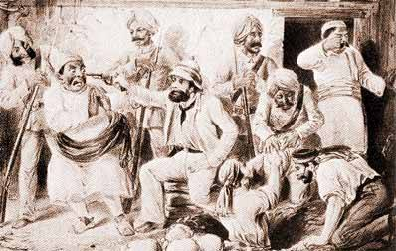
British East India Company Agents
From 1757 to 1858, the East India Company is the leading power in India.

Slide 5
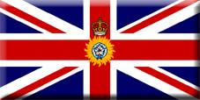
The Raj:
"Jewel in the Crown"
of the
British Empire

Slide 6
By the 1850s, the East India Company controlled almost all of India.
The British monarch appointed an official called a viceroy to govern the company’s territory in India.
Under its indirect rule, the British imposed harsh taxes and land reforms on Indian farmers.
The British worked hard to undermine Indian languages and traditions.
It was mostly the upper Indian classes who benefited from the British as they were the landowners. (which class would that be in the caste system?) They sent their kids to British schools.
The peasants became increasingly poorer.
British demand for cash crops and population increases strained food supplies and widespread famines often made conditions desperate.
Under British control, Indians were treated as second-class citizens in their own country.

Slide 7
British
Colonial Life
During the Raj
Raj was the term used to describe any part of India under British rule,
from 1757 to 1947.

Slide 8
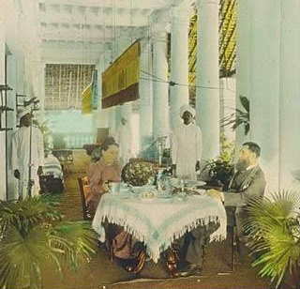
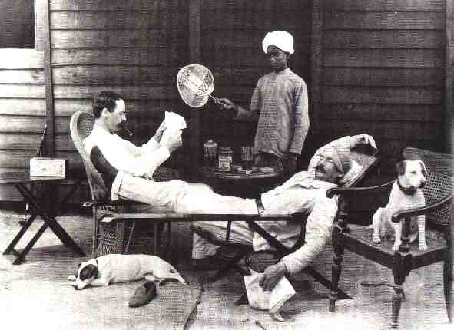
A Life of
Leisure!

Slide 9
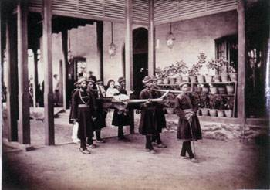
Br. Viceroy’s Daughter:
Simla, 1863

Slide 10
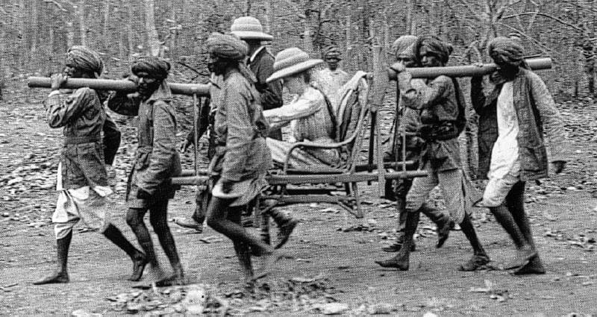
Lady Curzon, 1904

Slide 11
Impact of British Rule in India
Policies and Regulation
At first the East India Company ruled with little interference from the British
government until the 19th century. The company employed its own army and even had
an internal government structure. The British used India for the gain of Britain’s
Economy, and set up restrictions that didn’t allow India to operate on its own.
Positive Effects
A huge railroad system was placed in India by the British, making trade much more
efficient and brought together regions. The British modernized India by creating
telegraph, telephone, bridges, modern roads, canals and improving public health.
Schools and colleges are founded. They also helped put an end to local warfare.
Negative Effects
The British held almost all political and economic power and set restrictions on Indian
owned industries. Many villagers lost self- sufficiency due to the British enforcing cash
crops. Most British carried racist attitudes towards the Indians in the country, and
adopted policies which did not abide by many religious practices in India. Traditional
Indian life was threatened due to British superiority.

Slide 12
The
Rise of
Indian
Nationalism

Slide 13
You knew it was going to happen…
By the late 1800s, many Indians began to
question the intentions of the British.
A group of Indians created the Indian National Congress (sound familiar???)
More and more Indians began to
demand independence from Britain.

Slide 14
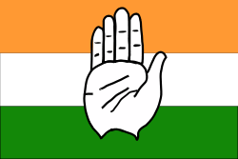
Nationalism Surfaces in India: the Indian National Congress and Muslim League form
Nationalist feelings began arising in the country due to modernization and the taking up of western ideas. It wasn’t long before the groups wanting to self govern themselves. Two Major Nationalist Groups formed:
The Indian National Congress
In 1885, the Indian National Congress formed- comprised mainly of Hindus wanting to break free from British rule.
The Muslim League
In 1906, the Muslim League formed- another nationalist group which focused on specific concerns for the Muslim minority living in India.
Above: Current flag of Indian National Congress

Slide 15
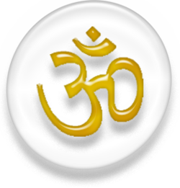

Nationalism Surfaces in India: the Indian National Congress and Muslim League form
Not only were Indians struggling to break away from British rule, but they were also struggling internally due to tensions between Hindus and Muslims.
The formation of the Indian National Congress and the Muslim League defined a fine line between the two major religions and their views.

Slide 16
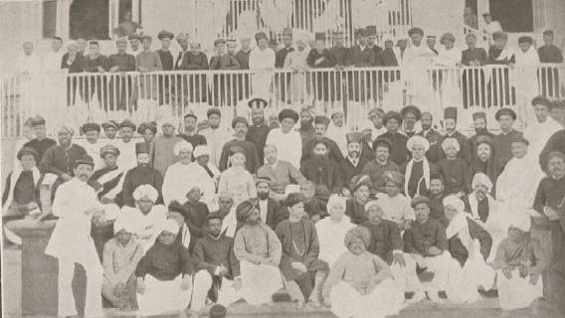
The Indian National Congress
1885 → The Indian National Congress
was founded in Bombay.
swaraj → “independence.”
* the goal of the movement.

Slide 17
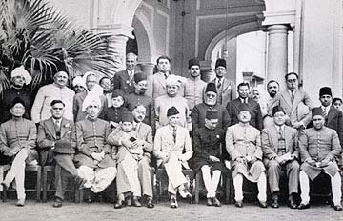
the Muslim League
1905 → partition of Bengal based on
religions and languages.
1906 → creation of the Muslim League.

Slide 18
GANDHI
Mohandas Gandhi, often called the Mahatma or “Great Soul” was born in India on October 2, 1869. To a merchant or Vaishya cast mother and father of the Hindu religion. Because he came from money, his parents were able to send him to England for a better education.
He and his followers threw the King of England and his great armies out of India without using weapons of any kind - unless you call a cotton spinning wheel a weapon!

Slide 19
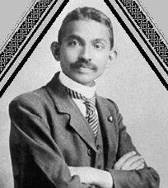
Gandhi as a Young Barrister in Natal
After Law school he moved to S. Africa as a lawyer. While here he witnessed how badly the white South Africans were treating people of color, Indians like himself and black Africans, he decided to do something about it.

Slide 20
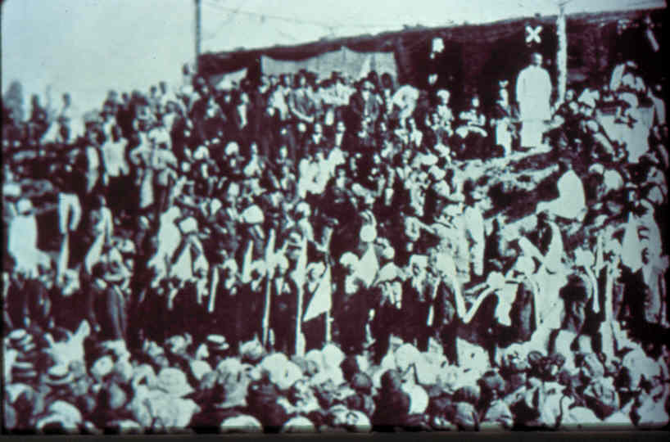
He led huge non-violent protests something he called Passive Resistance, to change the laws so that people working for the railroads would be treated more fairly. He started dressing in plain, white clothing that wrapped around his body, like the common people and he began to live very simply. After he had helped some of the people in South Africa get better treatment, he returned to India.

Slide 21
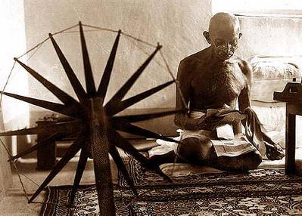
Gandhi Spinning Cloth
He and others believed India should have its freedom and get rid of the English rulers and their army. So he taught his people to fight back at the English - but not with guns or other weapons. He didn’t want to hurt or kill anyone. One way he taught his Indian friends to go against the English was by making their own cloth instead of buying cloth from the English. You see the English would have cotton grown in India, then they would have it picked by Indians, put on ships, ship it to England where it would be spun into thread, woven into cloth, shipped back to India and sold to the Indian people for a higher price. In fact, the English had laws that forced the Indians to buy only their cloth.
Gandhi said, “NO WAY, that is not fair!!” Why should we have to buy back our own cotton cloth?! Let’s spin it ourselves!” So he learned how to spin cotton thread on a spinning wheel - like in this picture - and weave it into cloth. He and his followers taught this old fashioned way of spinning and weaving to thousands and thousands of other Indians.

Slide 22
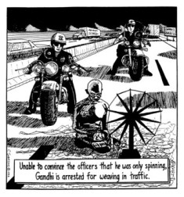
Gandhi Spinning Cloth

Slide 23
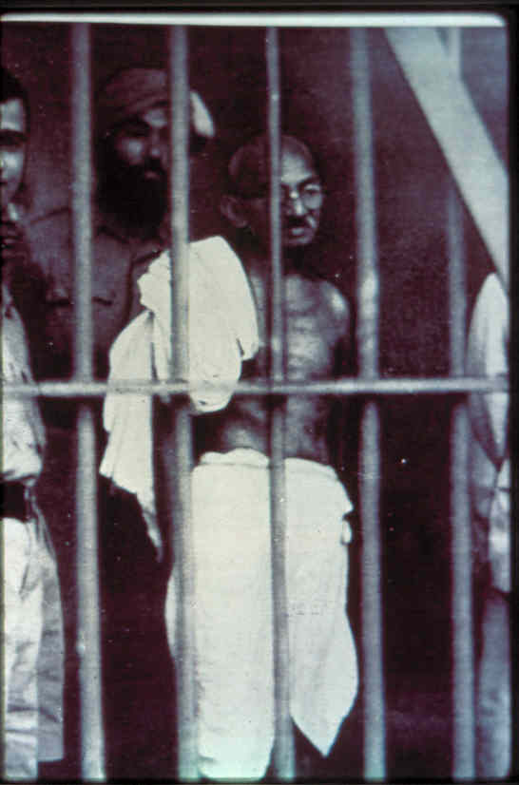
Soon the English couldn’t make money off the Indians buying their cloth anymore. The English said they had to buy the English cloth or go to jail, but Gandhi and his followers refused. Gandhi and hundreds of others were thrown in jail.
He would be let out of jail but he would keep spinning and weaving and keep breaking the law and get thrown in jail again and again.

Slide 24
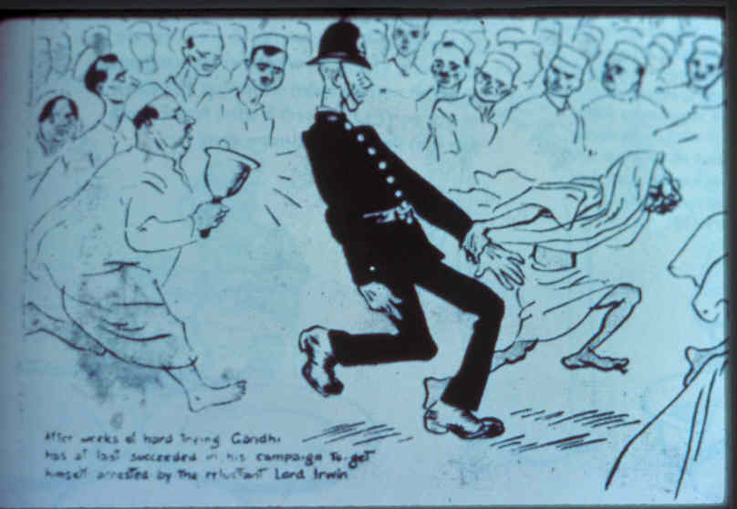
This made big news all over the world. People around the world soon began to think that this wasn’t fair either. Even the workers in the cloth factories back in England thought this was not fair. These were the people whose jobs were being lost because of Gandhi and his supporters making their own cloth. Finally the laws about the cloth were changed and Indians were allowed by the English to make their own cloth.

Slide 25
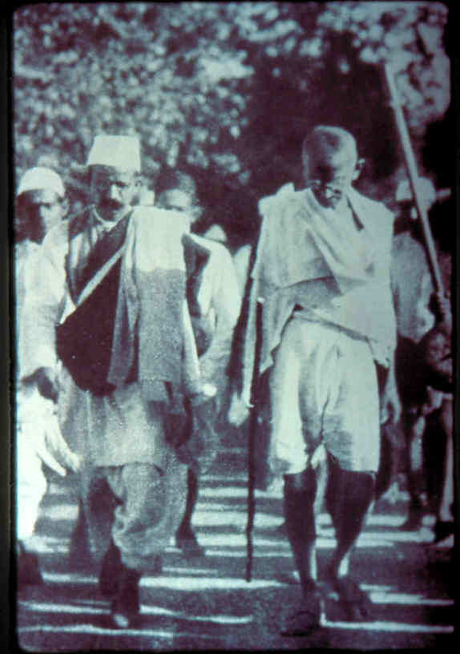
Next he protested against the English Salt Tax.
Here he leads his fellow freedom fighters on a march to the sea to make their own salt from sea water instead of buying the expensive English salt with its extra tax.
The English army beat up Gandhi and his followers and threw them in jail when they tried to make their own salt from the sea.
But Gandhi and his friends kept coming back and back until the English gave up.

Slide 26
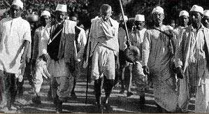
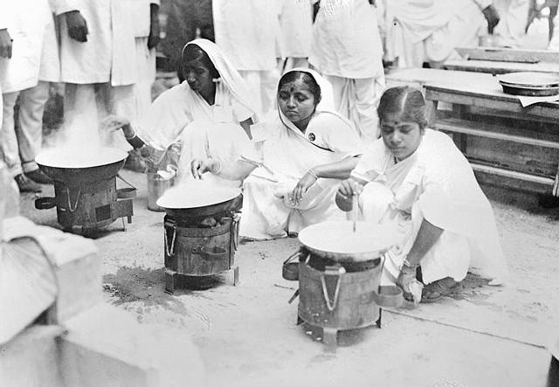
Salt March, 1930
Making
Salt

Slide 27
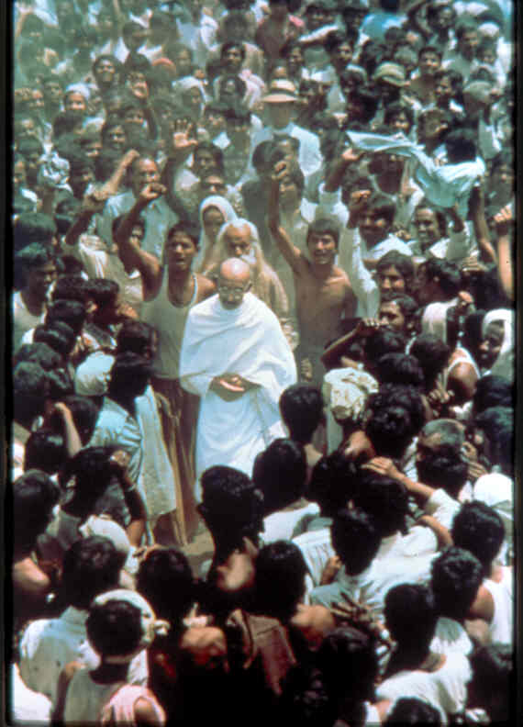
Finally, after years and many, many non-violent protests like this, Gandhi and his hundreds of thousands of freedom fighters forced the English to leave India and allow the Indians to run their own country. They did this without weapons that could hurt or kill.
Gandhi’s ideas of Passive Resistance - or trying to change unfair practices or laws without hurting anyone - have been used by important leaders in our country and around the world.

Slide 28
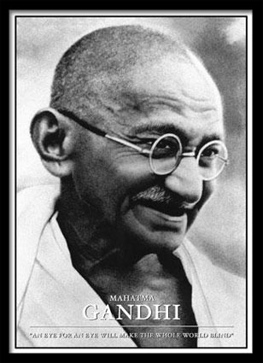
Mohandas Gandhi
A man named Mohandas Gandhi led the Indian Independence movement.
His strategy of non-violent protest convinced millions of Indians to support independence.
He used fasts, peaceful protest marches, and boycotts of British goods.
India was finally granted independence from Britain in 1947.
Gandhi was assignated in 1948 by a Hindu extremist who was upset that Ghandi had helped bring all religious groups in India together to share power in the new government.
"An eye for an eye will make the whole world blind"... Gandhi

Slide 29
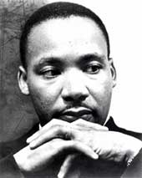
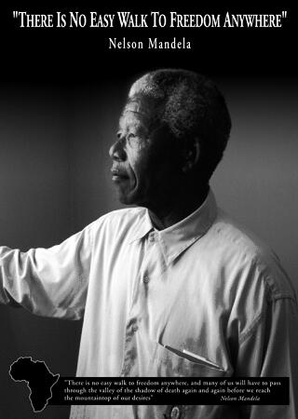
Mohandas Gandhi
Can you think of any other great leaders in Modern History that have followed Gandhi’s strategy of Passive Resistance ?

Slide 30
Before India became an independent country,
Tensions between Hindus
and Muslims began to rise…
India’s Muslims were afraid they would not have a say in the new government, once Britain granted independence.
To avoid a civil war, the British government agreed to the partition of India.
In 1947, India gained independence, and the country of Pakistan was formed for Muslims. About 10 million people crossed the border into Pakistan.
Soon after these 2 countries were formed, other countries in the region gained their independence from Britain as well.

Slide 31
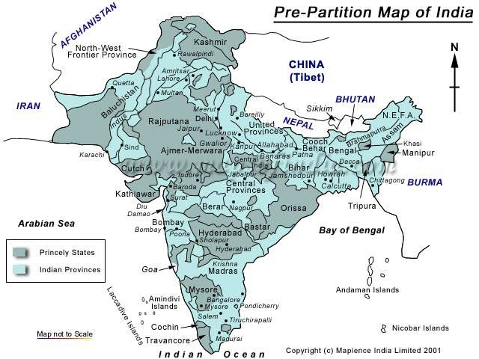
Pre-Partition

Slide 32
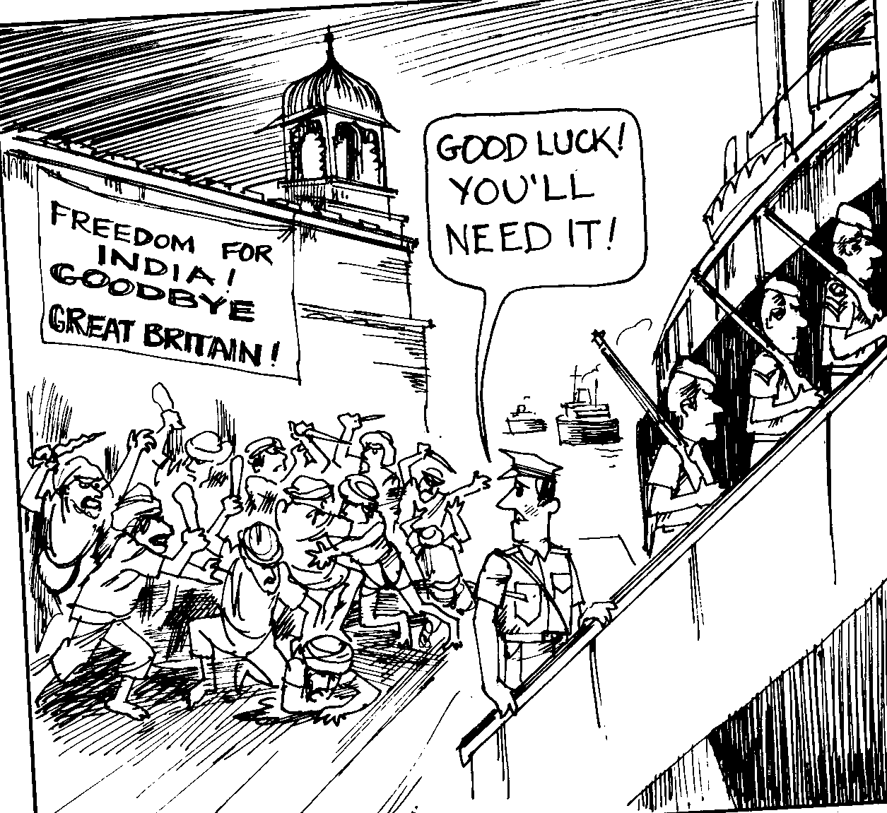

Slide 33
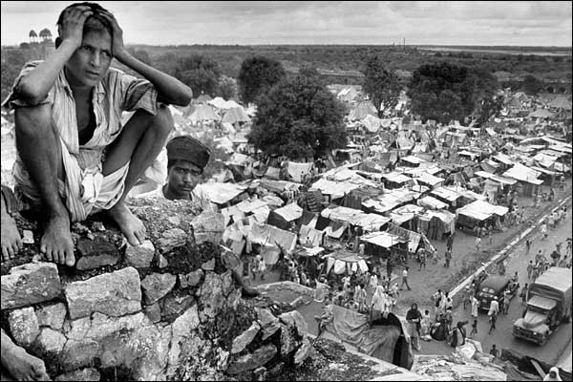
The Partition of India
August 14, 1947

Slide 34
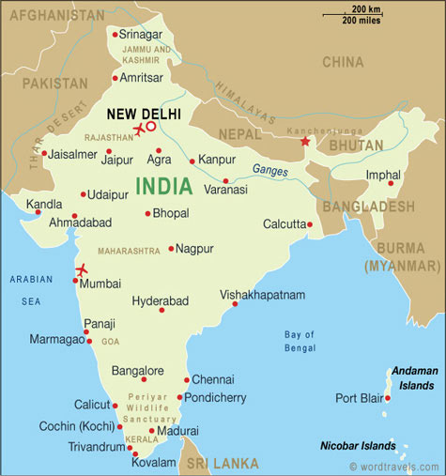
What is the Partition of India?
The partition of India was the
separation of India on Aug. 14,
1947 and Aug. 15, 1947 into the
countries of the Dominion of Pakistan
and the Union of India, respectively.
India was separated on the day of
gaining independence from British,
due to tensions between the Hindus
and the Muslims living in the country.
India gained independence after 350
years of British presence in the
country.
Above: A current day map of India

Slide 35
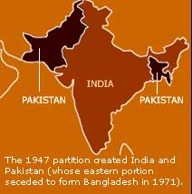
Partition!
India was formed out of the mostly Hindu regions and Pakistan was formed out of the mainly Muslim regions. Pakistan was formed in two dominions- East Pakistan and West Pakistan, which were separated geographically by India.

Slide 36
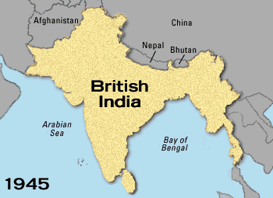
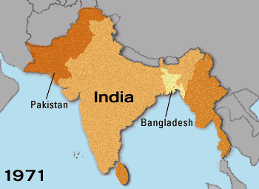
Basic Maps of the Partition
These two maps show how India was divided after gaining independence from the British in 1947. The first shows India under British rule, before the partition. The second shows how the region was divided after gaining independence and the breakaway East Pakistan (now Bangladesh) gained its independence from West Pakistan (Pakistan today) in 1971 through the Bangladesh Liberation War.

Slide 37
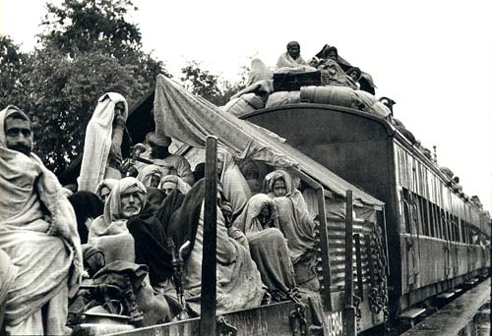
Impact and Aftermath of Partition
The partition of India left both India and Pakistan devastated. Riots erupted, and widespread looting broke out. Women were raped and battered by both the Hindus and Muslims, and trains full of battered women and children would arrive between the borders of India and Pakistan daily.
Refugee train of Sikhs heading to India
Right:.

Slide 38
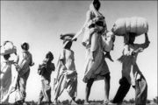
Impact and Aftermath of Partition
Over 15 million refugees were forced into regions completely new to them. Even though they shared the same religion of their new home, they still had not lost the bond to the region their family and ancestors grew up in. The provinces of Bengal and Punjab were divided causing outrage in many Muslims, Hindus, and Sikhs alike.
Man carrying wife and family across the border.

Slide 39
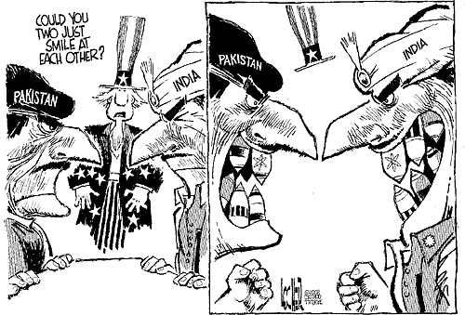
Impact and Aftermath of Partition
Even after almost six decades after the partition, India and Pakistan have still not healed from the wounds left by the partition. India and Pakistan have been to war twice since the partition, and Pakistan suffered the bloody war of the breaking away of East Pakistan into Bangladesh. The two countries are still arguing over the landlocked region of Kashmir. Many believe the partition not only broke the unity of India, but also took away the sense of belonging to many people who were tore apart from their native regions.

